Slide 1
Pairwise Contrastive Fine-Tuning for Patent Classification
By Mridul Jain and Lynne Wang
July 2025 - NLP Course (MIDS 266), UC Berkeley
https://github.com/lwang9/mids-w266-final-project
Notes:
AI-generated content may be incorrect. --- This presentation explores a novel approach to enhance CPC patent classification by leveraging contrastive learning techniques. We focus on improving section-level classification accuracy through innovative fine-tuning methods and a mixture of experts model architecture.

Slide 2
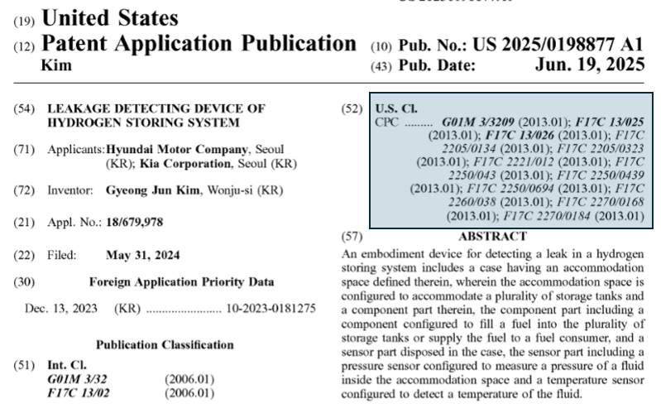
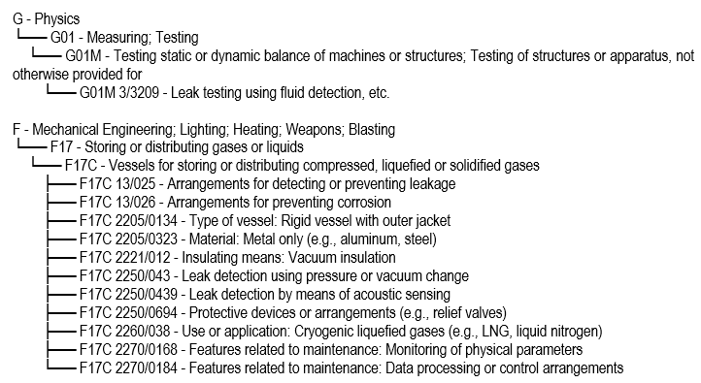
CPC Hierarchy: Structure, Size, and Complexity
Notes:
--- The Cooperative Patent Classification (CPC) system is extensive and hierarchical, with multiple levels and thousands of categories. This complexity makes manual labeling difficult and motivates the need for automated, scalable classification solutions. Image source: Microsoft 365 content library

Slide 3
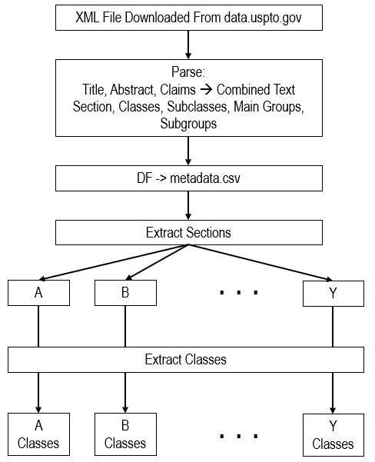
Data Preprocessing

Slide 4
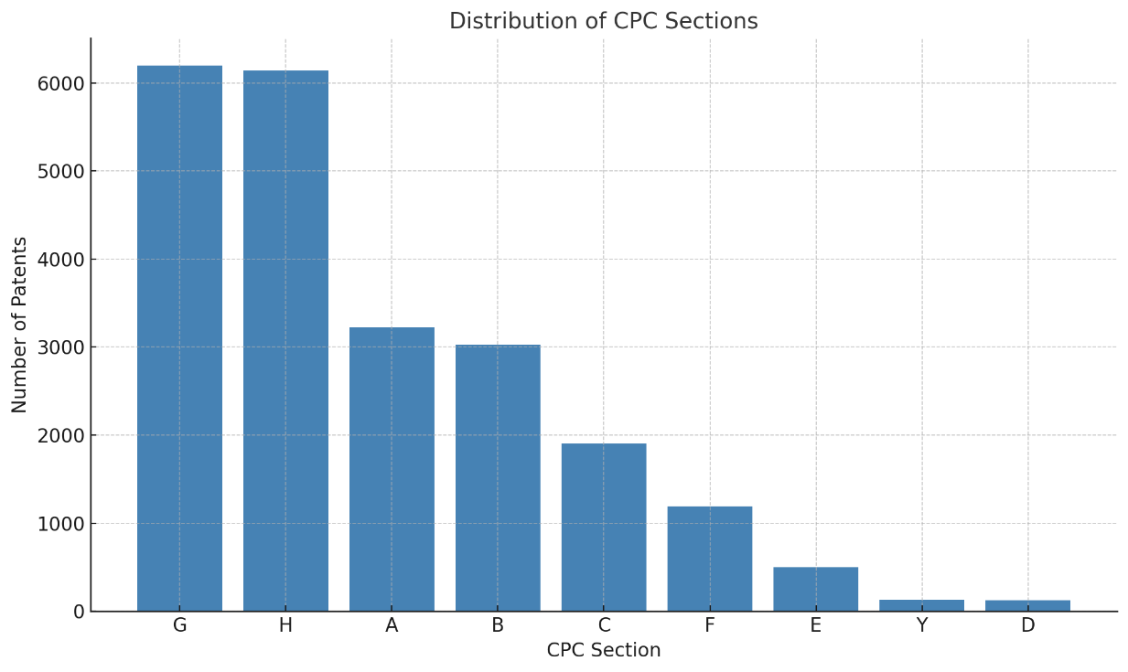
Highly Imbalanced Distribution

Slide 5
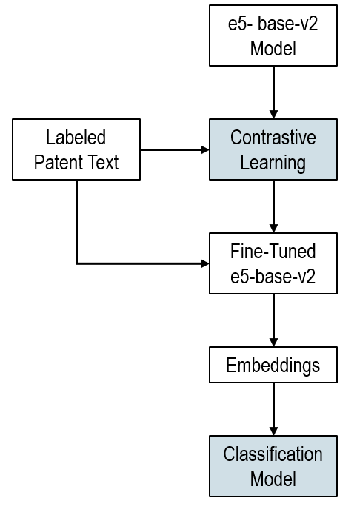
Two-Stage Process: Contrastive Fine-Tuning and Mixture of Experts Classification
Contrastive Fine-Tuning
Fine-tuning E5-Base-V2 embeddings enhances semantic separation through contrastive learning techniques.
Mixture of Experts Classifier
Expert classifier integrates embeddings and taxonomy features to accurately predict CPC sections.
Notes:
--- First, we fine-tune the E5-Base-V2 embeddings using contrastive learning for better semantic separation. Second, a mixture of experts classifier leverages these embeddings along with taxonomy features to predict CPC sections. Image source: Microsoft 365 content library

Slide 6
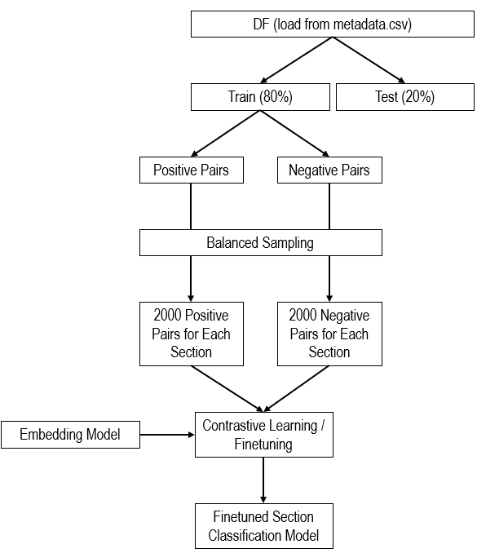
Stage 1: Contrastive Fine-Tuning of E5-Base-V2 Embeddings
Notes:
--- Contrastive fine-tuning adjusts E5-Base-V2 embeddings to cluster patents from the same CPC section closer while pushing different sections apart, enhancing discriminative power for classification. Image source: Microsoft 365 content library

Slide 7

Incorporation of Taxonomy-Aware Features Using CPC Descriptions
cpc_class_list = [
["A01", "Agriculture; Forestry; Animal Husbandry; Hunting; Trapping; Fishing"],
["A21", "Baking; Equipment for making or processing doughs; Doughs for baking"],
["A22", "Butchering; Meat treatment; Processing poultry or fish"],
["A23", "Foods or foodstuffs; Their treatment, not covered by other classes"],
["A24", "Tobacco; Cigars; Cigarettes; Smokers' requisites"],
["A41", "Wearing apparel"],
["A42", "Headwear"],
["A43", "Footwear"],
["A44", "Haberdashery; Jewelry"],
["A45", "Hand or travelling articles"],
["A46", "Brushware"],
["A47", "Furniture; Domestic articles or appliances"],
["A61", "Medical or veterinary science; Hygiene"],
["A62", "Life-saving; Fire-fighting"],
["A63", "Sports; Games; Amusements"],
. . .
Notes:
--- We enrich the model with features derived from CPC descriptions, enabling it to utilize hierarchical taxonomy information, which improves accuracy especially for closely related classes. Image source: Microsoft 365 content library

Slide 8
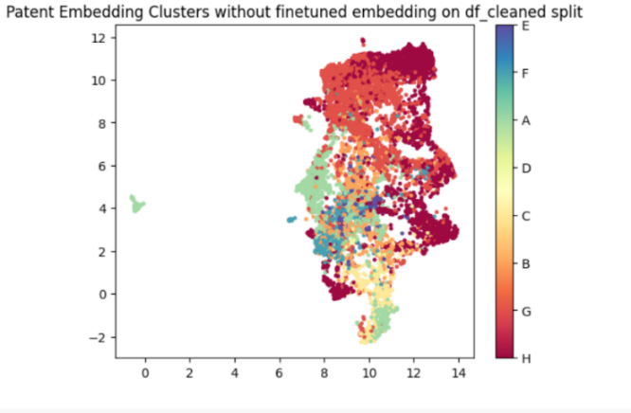
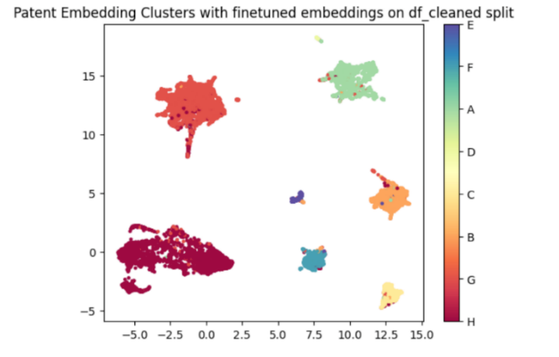
Embedding Space Before vs. After Fine-Tuning
Notes:
--- Training pairs are formed by grouping patents sharing the same CPC section as similar pairs, and those from different sections as dissimilar pairs, enabling the model to learn meaningful semantic distinctions. Image source: Microsoft 365 content library

Slide 9
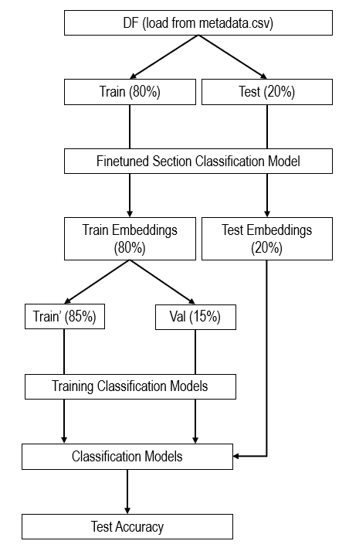
Stage 2: Training Classification Models
Notes:
--- Through contrastive loss, embeddings are tuned so patents within the same section cluster tightly, while those from other sections are separated in the embedding space, improving downstream classification. Image source: Microsoft 365 content library

Slide 10
Results & Discussion
Section | Our Model (MoE) | Our Model (Taxonomy Aware) | PatentSBERTa (2024) | Shajalal et al. (2023)
A | 0.87 | 0.85 | N/A | 0.85
B | 0.75 | 0.72 | 0.76 | 0.70
C | 0.80 | 0.76 | 0.86 | 0.81
D | 0.37 | 0.16 | 0.64 | 0.73
E | 0.64 | 0.64 | 0.74 | 0.67
F | 0.72 | 0.68 | 0.78 | 0.70
G | 0.83 | 0.83 | 0.85 | 0.82
H | 0.84 | 0.84 | 0.86 | 0.82
Y | 0.07 | 0.00 | 0.56 | 0.41
Micro Avg. | 0.81 | 0.80 | 0.80 | 0.78
Macro Avg. | 0.65 | 0.61 | 0.80 | N/A
Instance Avg. | 0.84 | 0.83 | 0.82 | N/A
Notes:
--- We evaluate our approach on a dataset of 20,000 patents extracted from the USPTO XML data as of 2025, providing a comprehensive and current benchmark for section-level CPC classification. Image source: Microsoft 365 content library

Slide 11

Next Steps
Expand training data for rare sections.
Extend to subclass, main group, subgroup.
Explore zero-shot classification using taxonomy embeddings.
Notes:
--- Our approach improves patent classification via pairwise contrastive fine-tuning and taxonomy-aware modeling, offering enhanced semantic embeddings and a flexible classifier architecture. Image source: Microsoft 365 content library

